Slide 1
The Voices Around The World Choir 2020
Remote Learning Song Project

Slide 2
“Sometimes, it seems like music is the only thing that makes any sense!” - We hope you are all safe and well right now.

Slide 3
This short video is to give you a preview of the songs and the resources for this year’s project.

Slide 4
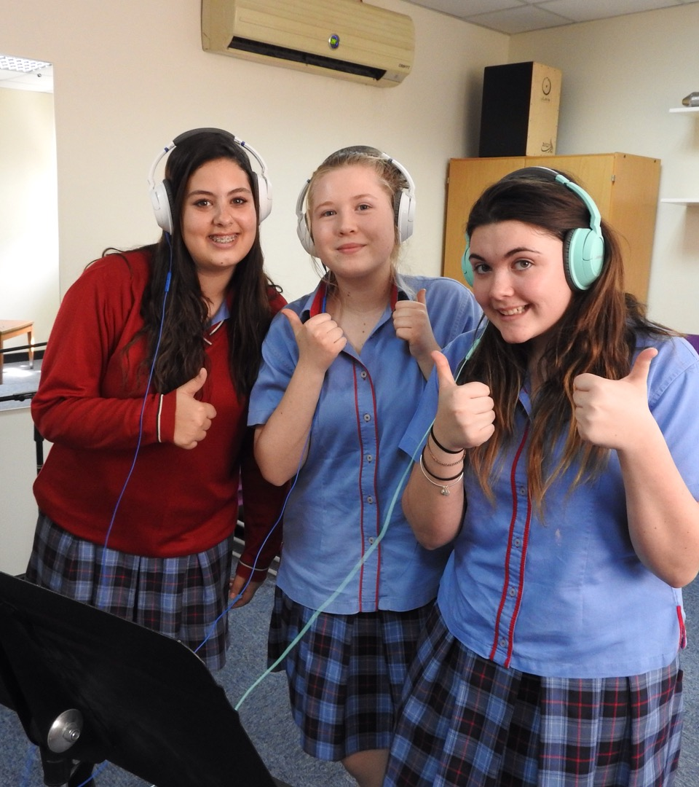
Voices Around The World 2020
Each year, we get young singers from all over the world to learn a song and then record themselves singing for the Voices Around The World Project. We make their recordings into one big mix and then release it world-wide!
This year, things are a little different with most schools being closed, but we think that this is a great opportunity to unite through music.
Join with other students around the world. Get involved in this year’s project.

Slide 5
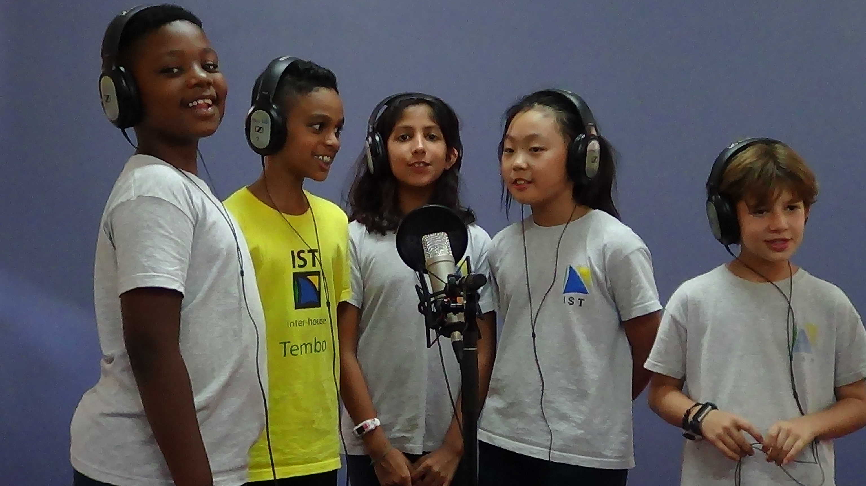
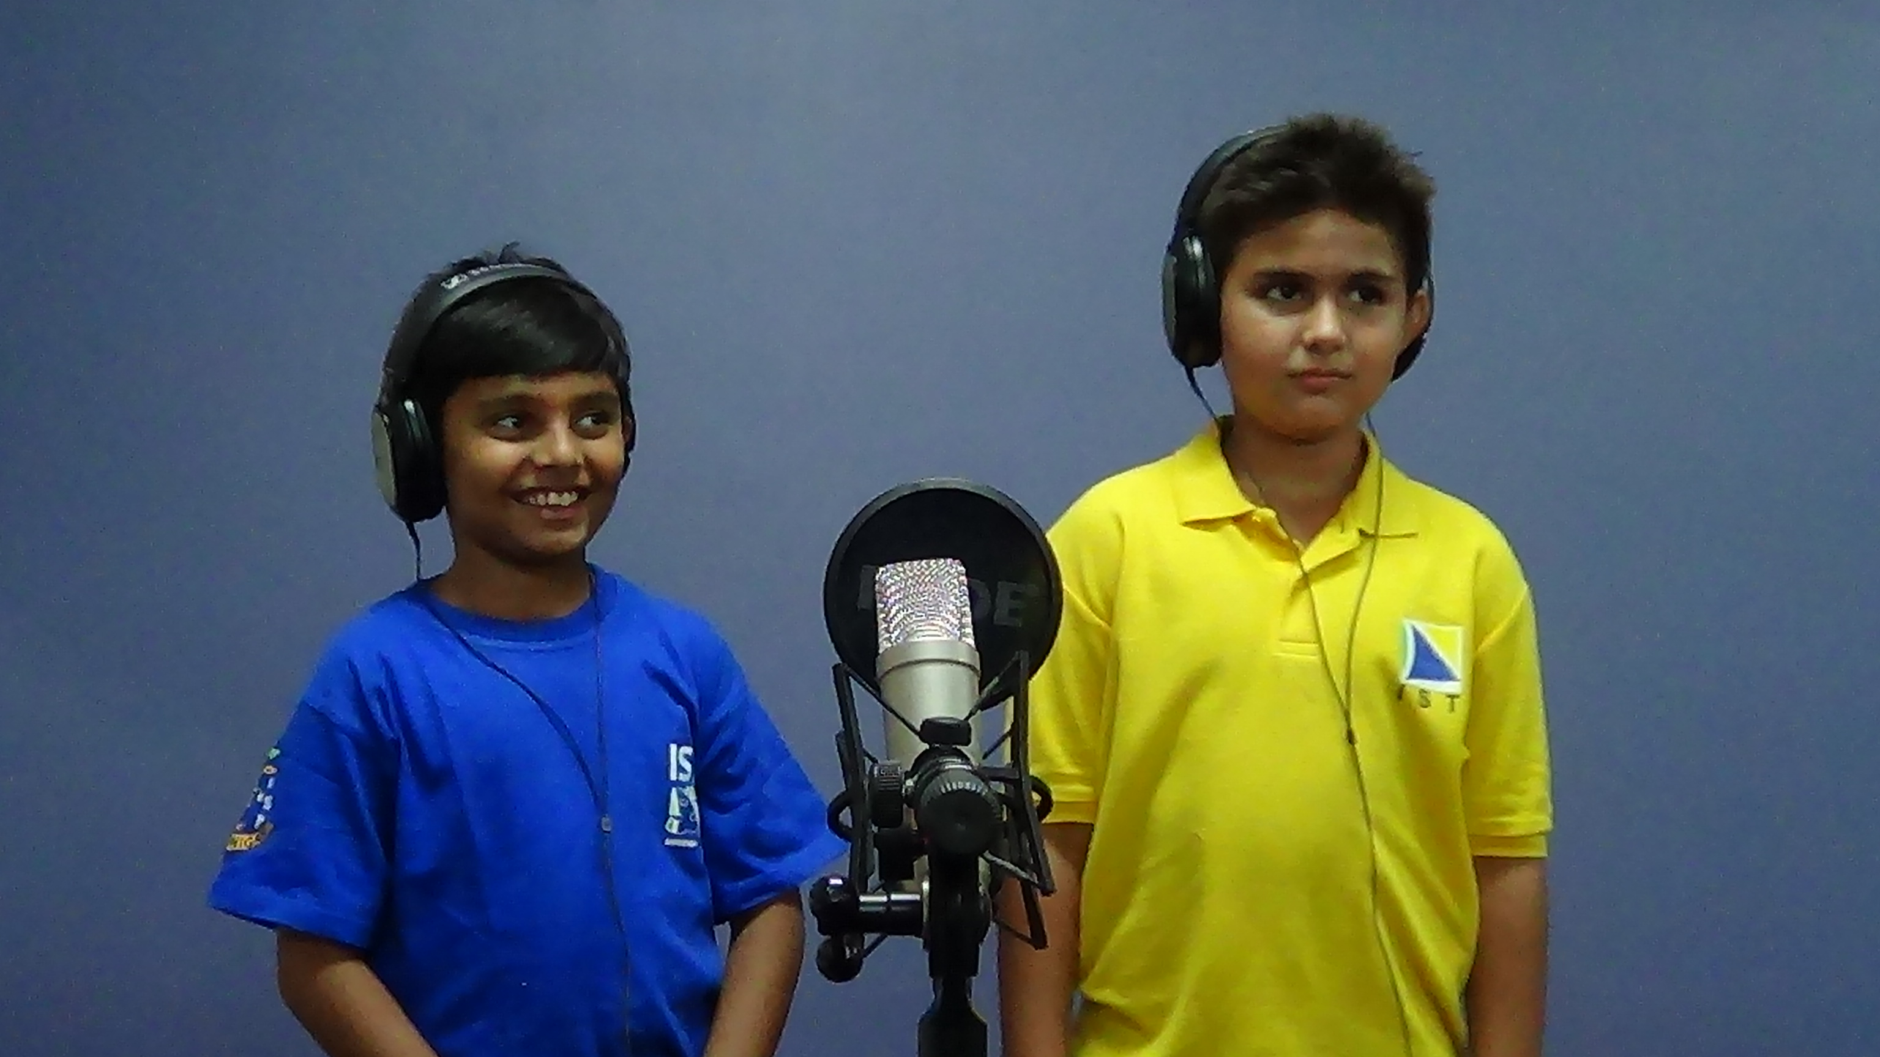
1.
Listen & Learn: Use the free resources we provide to learn the songs.
Student record a selfie video of them singing the song.
Important: - listening to the track on headphones and only recording their voice.
2.
3.
Audio/Video Uploaded to us on the VATW website.
Extension activity for older or superstar students: Create a harmony line upload your recording to VATW.
4.

Slide 6
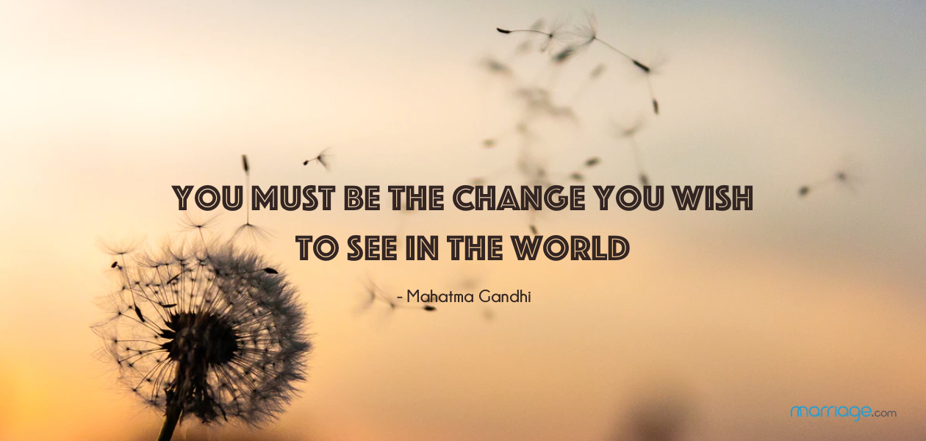
The message of this year’s songs...

Slide 7
‘WE ARE THE CHANGE’
Introducing one of this year’s songs...

Slide 8
Listen to or download the audio/karaoke tracks (here)
Read or download the lyrics (alsonext slide) and/ or follow the score (here)

Slide 9
We Are The Change
Lyrics & Chords
Chorus
E B
I am you, you are me
C#m A
We are everything we see
E B
We are the earth, the wind, the sky
A
And the mountains
E B
We are everything we’ve done
C#m A
We are everything under the sun, and
E B
We are the change
E A
We are the change
E B G-F#m-E
We are the change we all want to see
Bridge
Chorus
Middle 8
A Am E
Your life goes round and round in circles
A Am E
But you know, it doesn’t have to be that way
A Am
You’ve got to STOP, you’ve got to STOP
E C#m
And listen to the music in your life
F# F#m
And take a little time, to see the magic
B
That’s in your day
Verse 1
Emaj7 A
Everything happens in a single moment
Emaj7 A
Everything happens in the blink of an eye
Emaj7 A
You’ve got to seize each precious second
Emaj7 A
Can’t afford to let your life slip by
Bridge
A G#m
Everything you wanted
F#m E-F#-G
All your heart’s desires
A G#m
It’s there if you want it
F#
All you’ve got to do is reach out there
F#m
And try
Verse 2
Emaj7 A
You’re like a wave rolling in from the ocean
Emaj7
You’re like a star somebody plucked out
A
from the sky
Emaj7 A
It’s all a drip, drip, drip in that pond of emotions
Emaj7 A
It’s all the stuff of your magic carpet ride
Chorus
+ We all want to see x2
Outro
We are the change x4

Slide 10
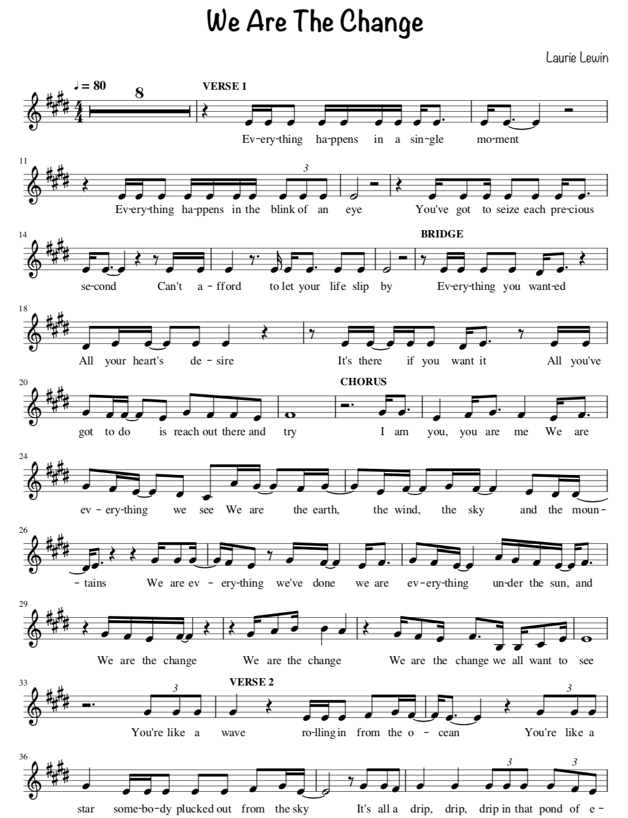
We Are The Change
Score for Vocal Melody
PDF file of vocal melody here

Slide 11
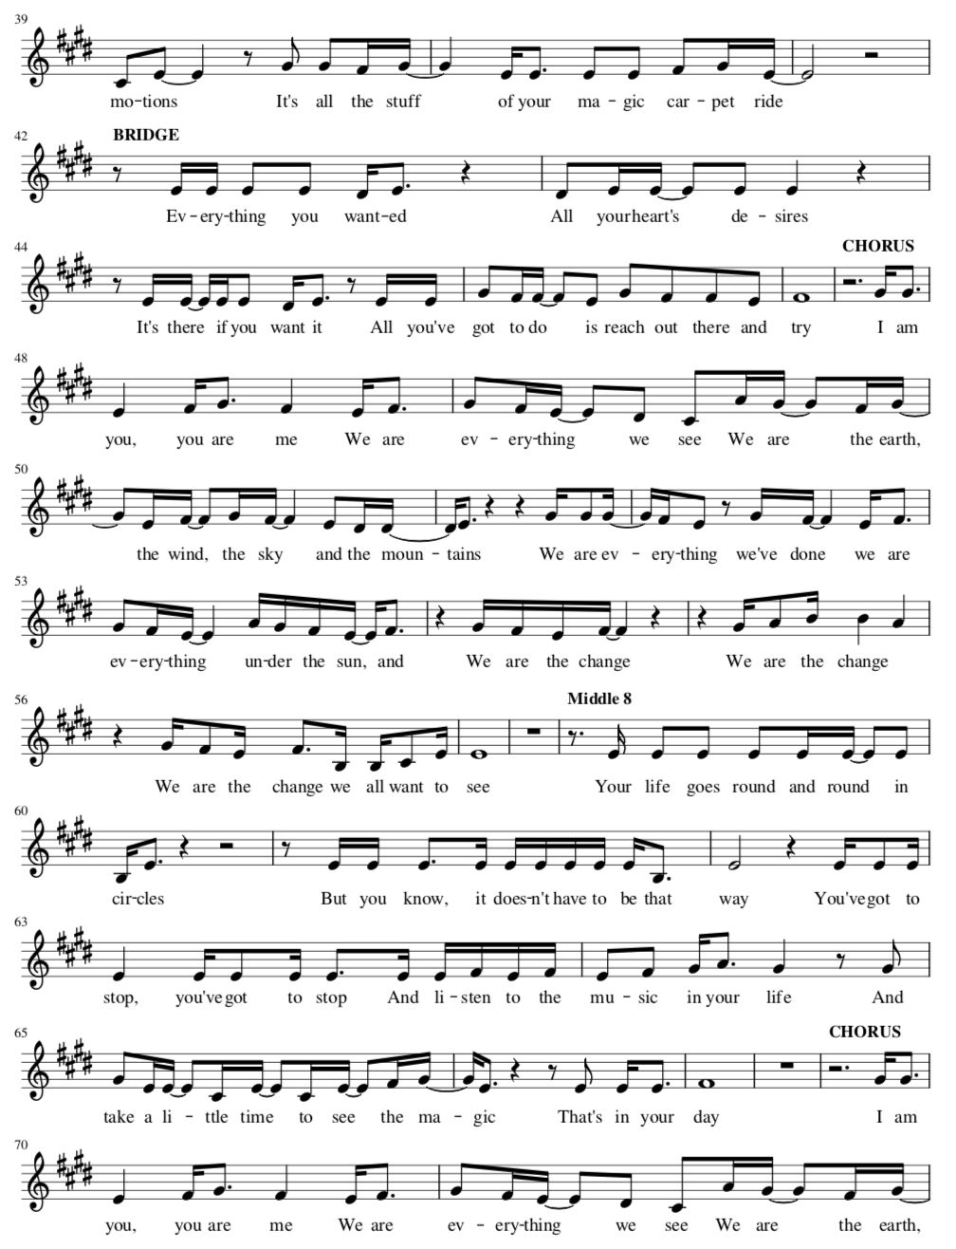
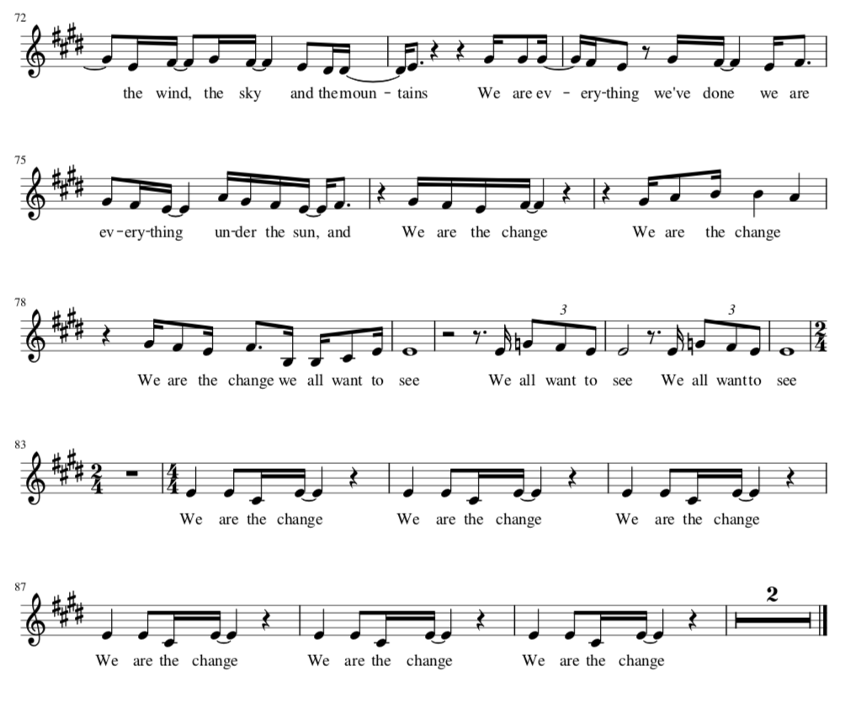

Slide 12
RECORD
Have the lyrics or score in front of you
Listen to the backing track with headphones on
You can choose to listen to the backing track with vocals or the backing track without vocals - whichever helps you the most
Record the video in selfie-mode so that we can see your face
Upload your video to Flipgrid here: (TEACHER INSERT THE LINK)

Slide 13
Good luck!
If you have any questions, please email your Music teacher who will be able to assist you.

